Slide 1

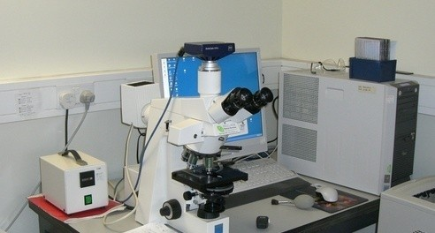
AUTOMATIC WHITE BLOOD CELLS IDENTIFICATION
SRI INDU INSTITUTE OF ENGINEERING AND TECHNOLOGY
Digital Camera
Microscope
-IMAGE PROCESSING Tech
KASIREDDY RISHITHA REDDY ( 18X31A0461 )
KALAKONDA LAHARI ( 18X31A0465 )
KOLA SATYA VARA PRASAD ( 18X31A0475 )
4TH YEAR—ECE (B)
UNDER THE GUIDANCE OF:
DR. D. LAKSHMAIAH
Professor and head of the department (ECE)

Slide 2
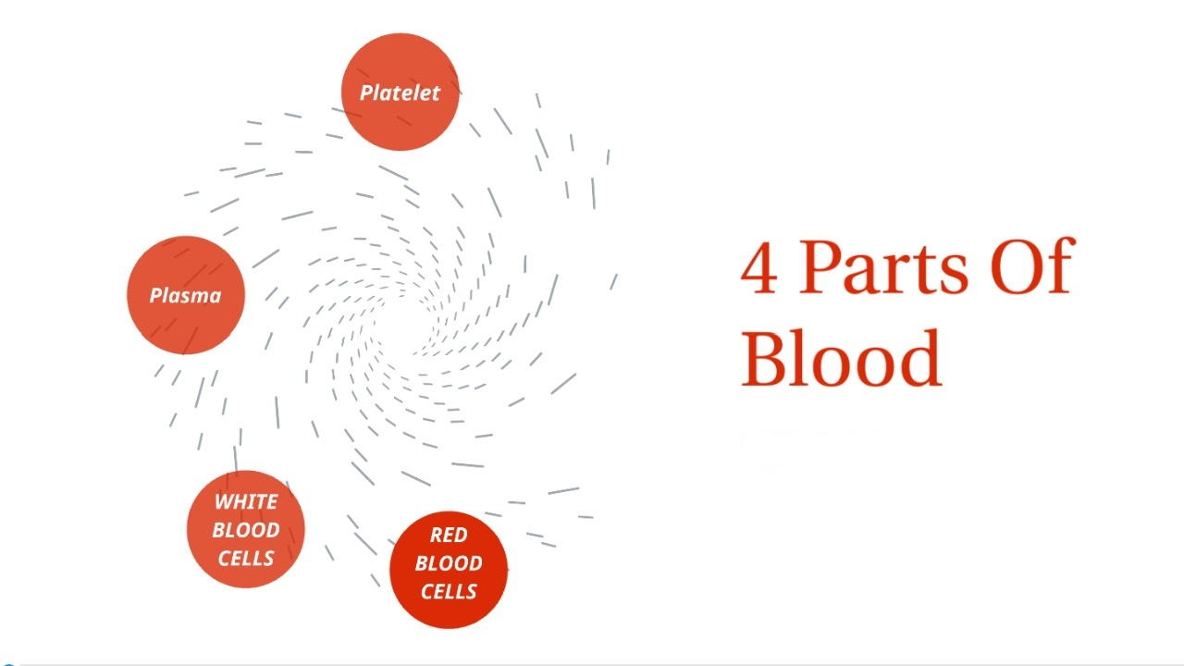
PROLOGUE
ABSTRACT
It is a one of the image recognition application in a medicine sector.
Vision Is the most advanced sense of mans life.(Image processing and machine learning)
Medical image are considered as a vital tool utilized for the diagnosis and analysis for many diseases .
Sample images :Peripheral blood (PB) smear.
Computer-aided microscopic morphological examination using image processing .
Using MATLAB image processing toolbox .
Blood, fluid that transports oxygen and nutrients to the cells and carries away carbon dioxide and other waste products.
4 Parts Of Blood
1. Platelets
2. Plasma
3. Red blood cells
4. White blood cells

Slide 3
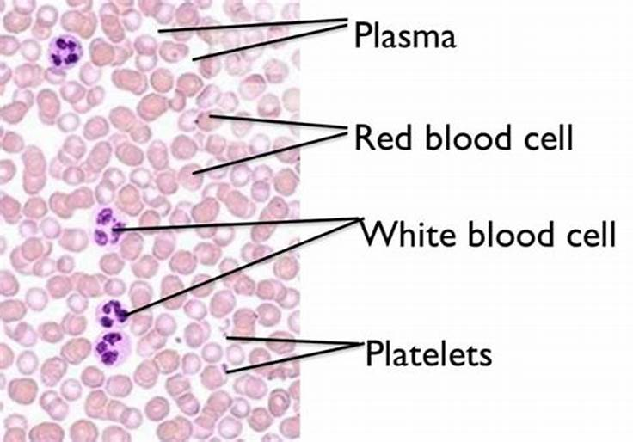
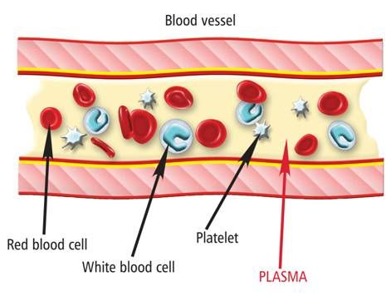
RED BLOOD CELLS: The Solid part of the blood cell that carries oxygen and removes CO2.
PLATELETS: The solid part of blood, It helps blood to clot when you have a cut or wound
PLASMA: liquid part -Plasma contains proteins that help the blood to clot, transport substances through the blood.
WHITE BLOOD CELLS: They are cells in our immune system(fights infection)
PB smear image view
General view

Slide 4
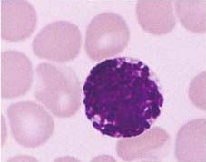
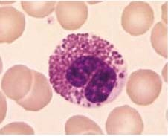
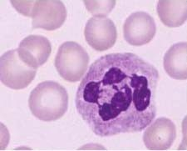
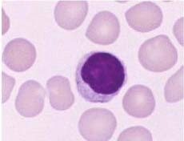
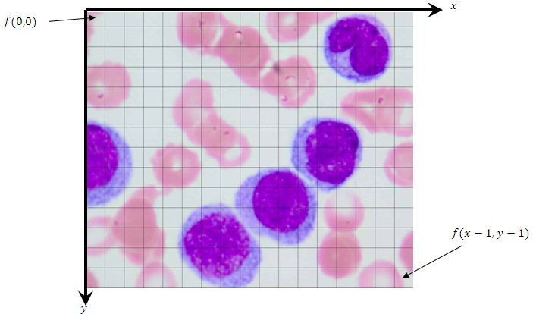
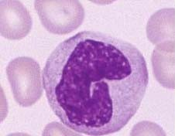
WBC Identification
5 types
Here nucleus sizes, area, and shapes are diff in all cases
So, We need to apply diff steps to identify them
BUT also as our project is about WBC identification so we need to remove remaining Blood components like RBC, Plasma & Platelets.
BY using an algorithm(Image Processing & ML tech) we can identify them.
Generally, the digital image is defined as a discrete two-dimensional function f(x, y).
Representation of Microscopic PB digital image

Slide 5

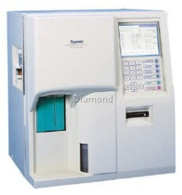
One of the most challenging problems in microbiological image processing is separating touching cells .
(i) increases the diagnostic accuracy, thus saving more lives, and (ii) decreases the number of false diagnoses, hence reducing the medical and emotional cost imposed on individuals by unnecessary laboratory tests.
Image processing and ML techniques have been applied by many researchers to solve this problem.
A short note on image processing steps.
Overlapping cells
hematology analyzer
(draw back of WBC identification up to 60%)
image acquisition, 2) image segmentation, 3) feature extraction and selection, and finally, 4) classification.
Exist system

Slide 6
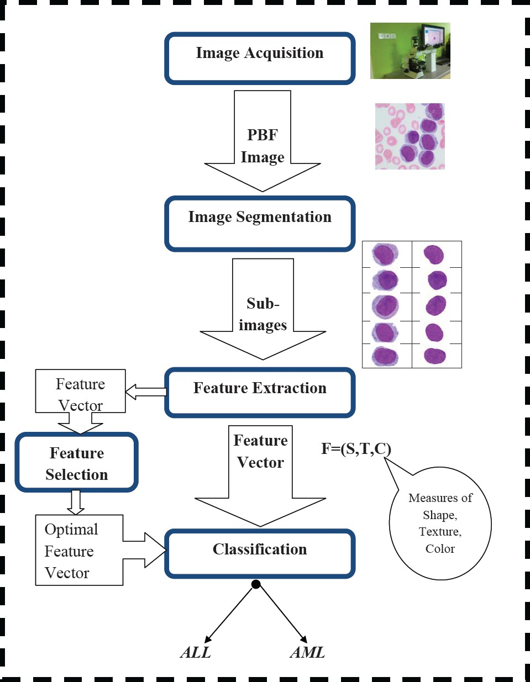
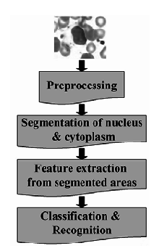
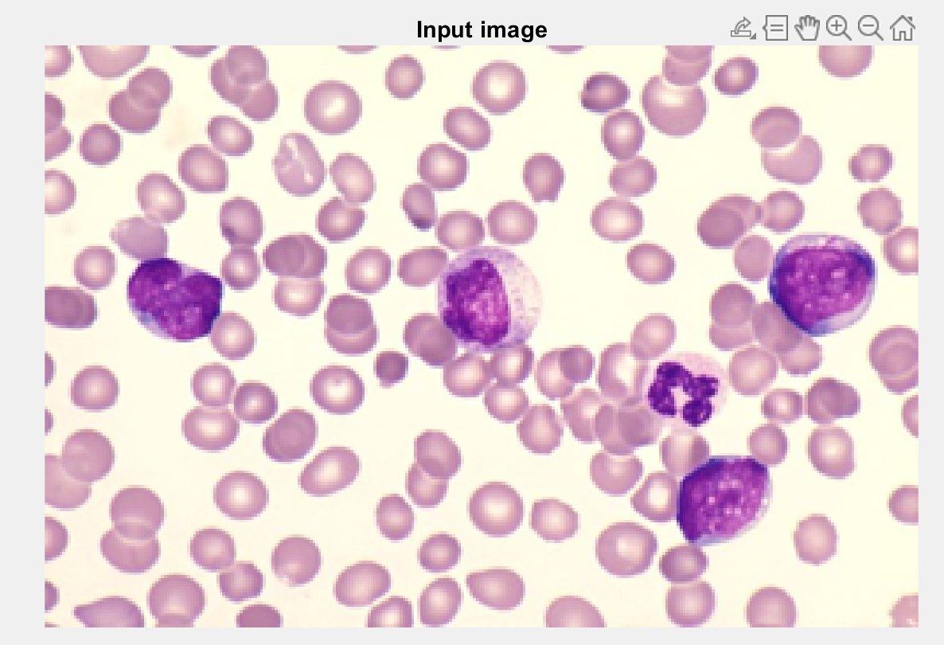
Block Diagram:
1. Image acquisition: The action of retrieving an image from the source.
_Preprocessing:Identifying boundaries of WBC by removing RBC.
Basic View

Slide 7
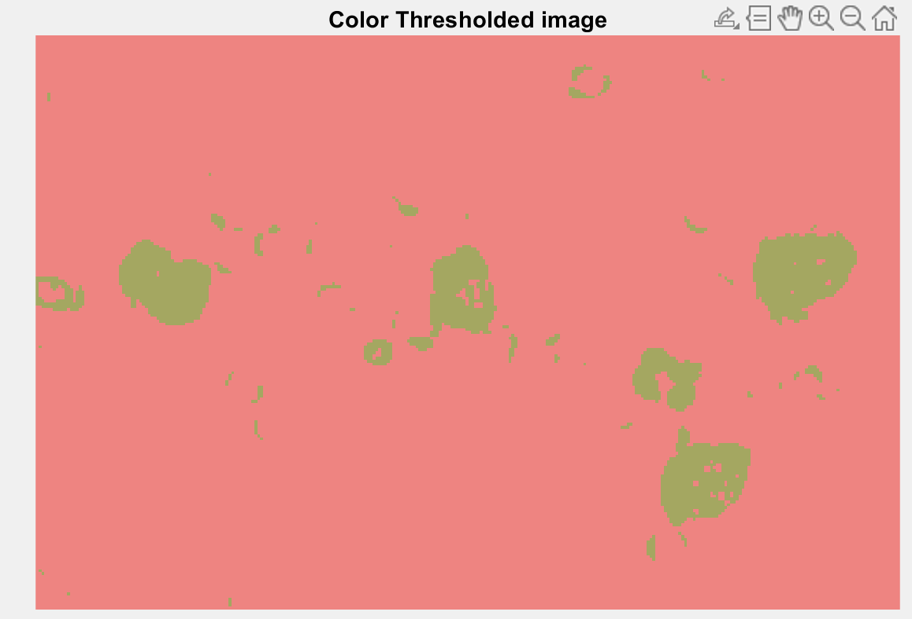
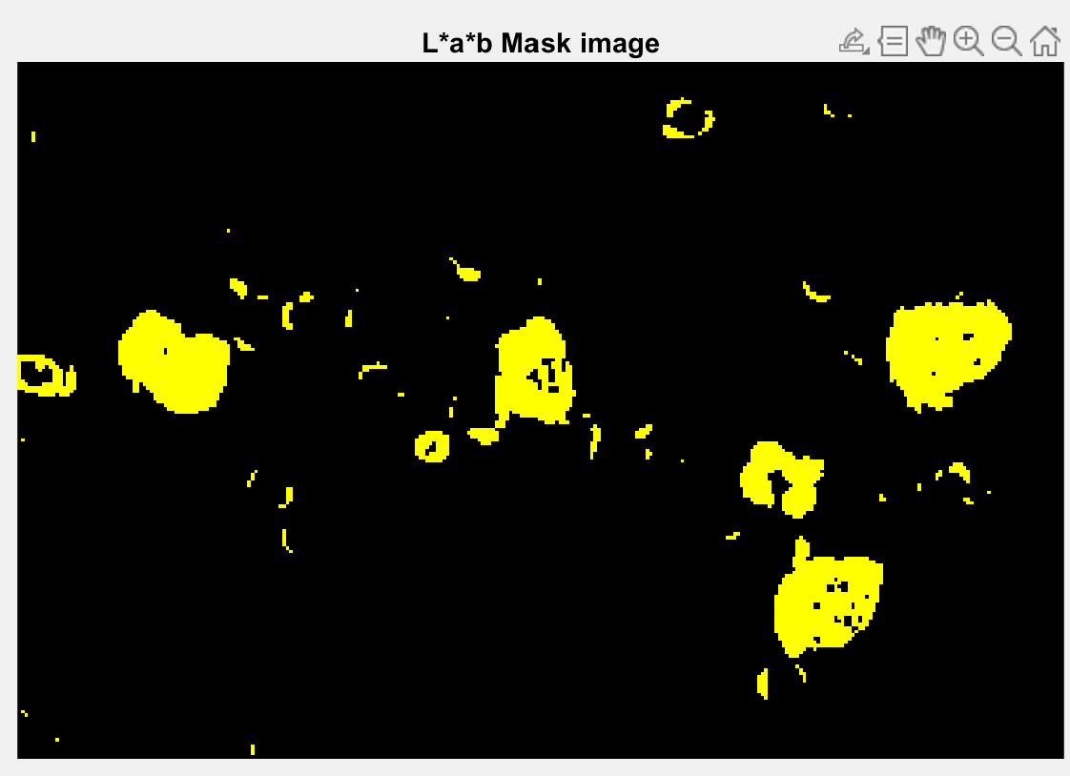
Color thresholded image: converting an image from color or grayscale into a binary image .
Threshold value: for image intensity T=0.008856
Gray scale: range 0 to 255.
Binary image: It is in the form of zeroes and ones.
Remove almost all the other blood components while retaining the nucleus with the minimum effect of distortion on the nucleus part of the white blood cell.

Slide 8
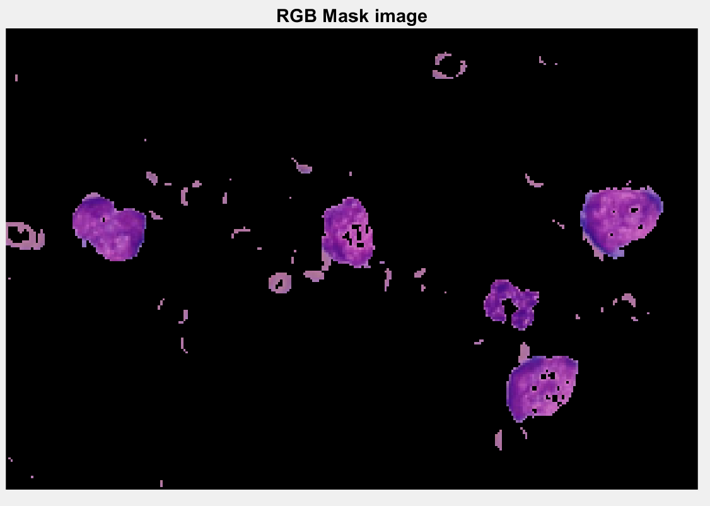
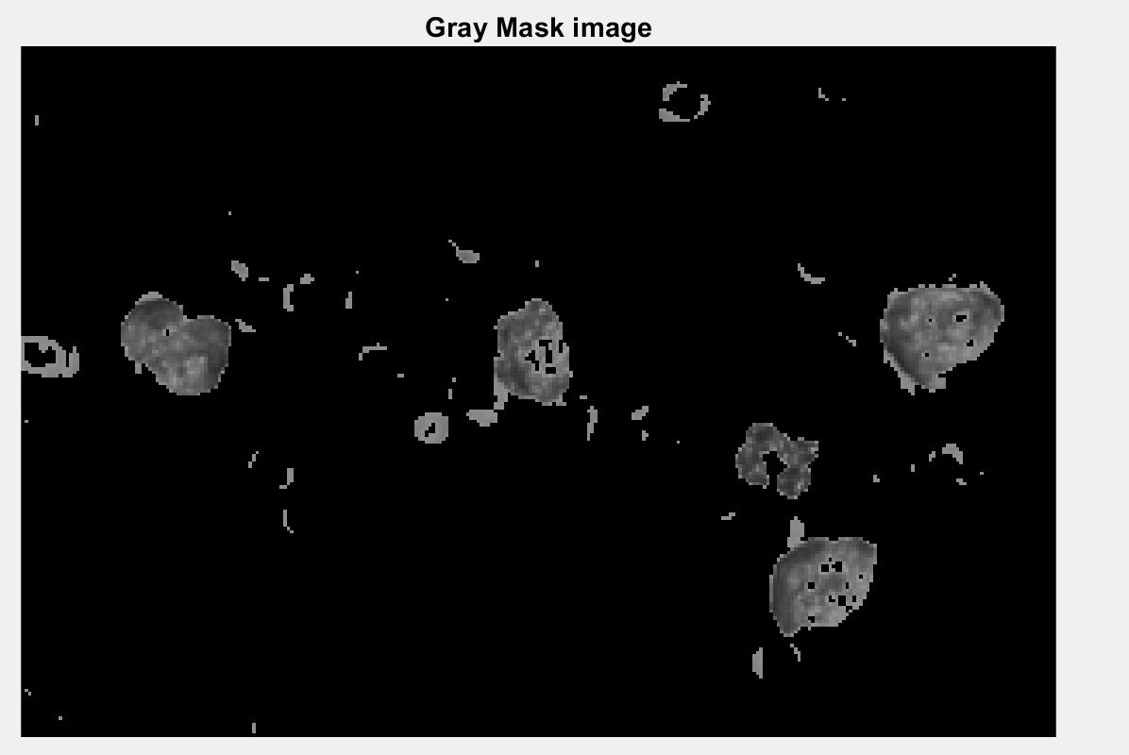
RGB: red green blue image is a 3-D byte array that stores color value in each pixel. RGB mask: coloring the mask by using RGB plain. Gray mask: simply one in which the only the colors of shades of gray. Here Background noise and platelets are identified and background noise is removed.

Slide 9
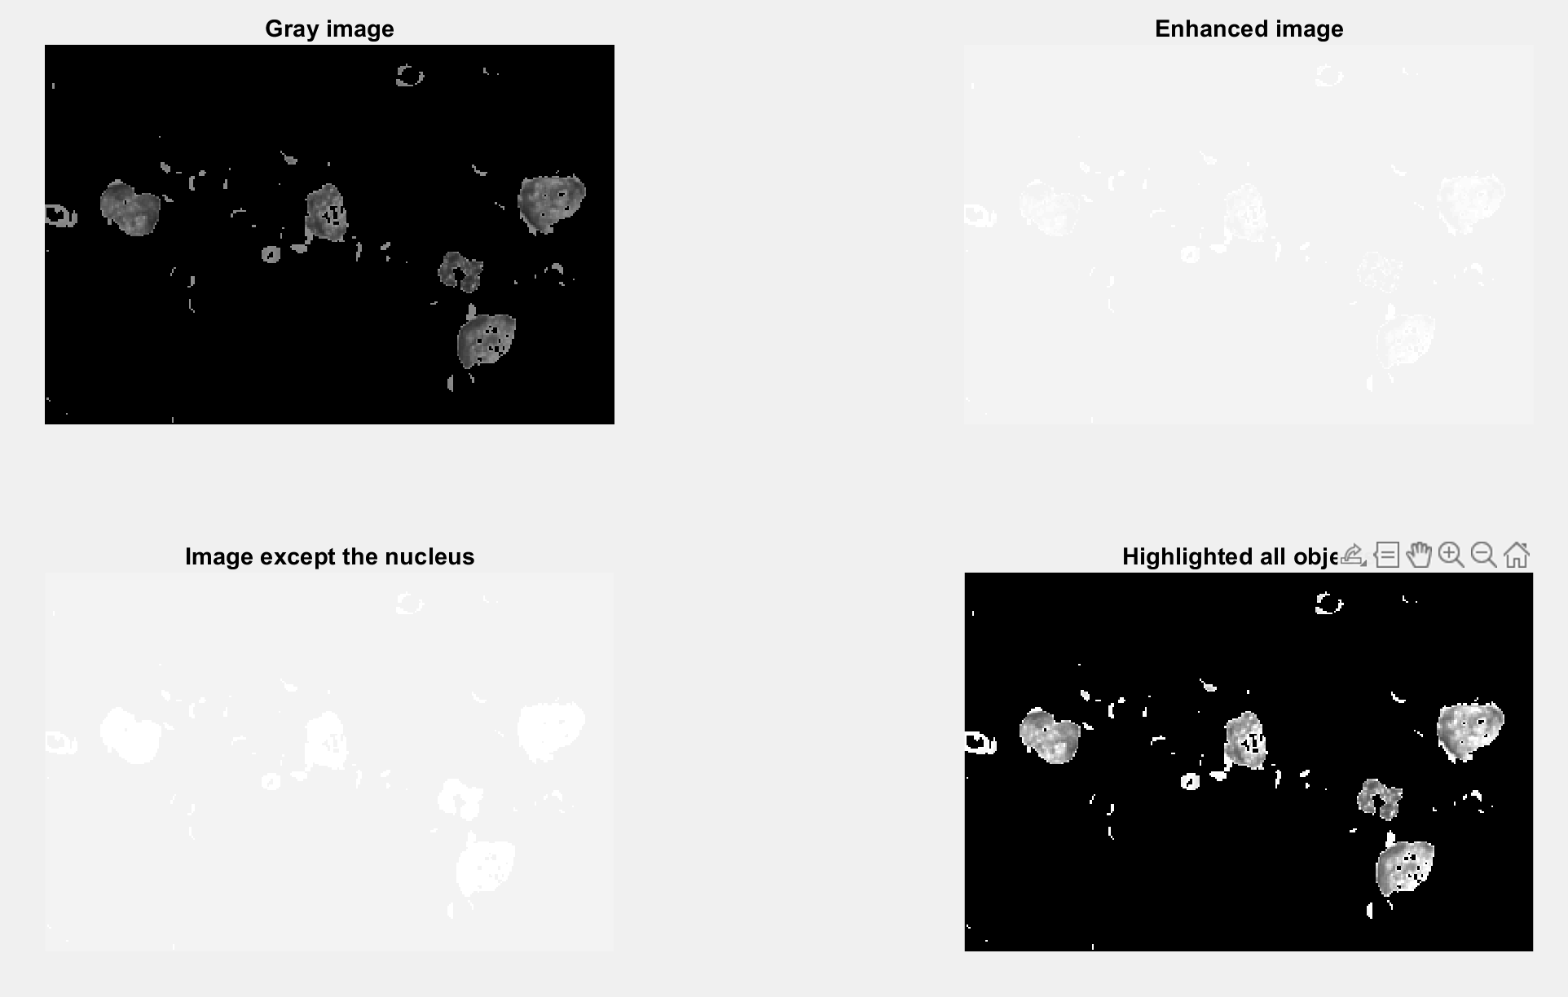
2.Image Enhancement :
The procedure of improving the quality and information content of original data before processing.
Brighten most of the details in the image except the nucleus
Highlight all the objects and their borders in the image including the cell nucleus
Intensity and image quality are improved for better vision.

Slide 10
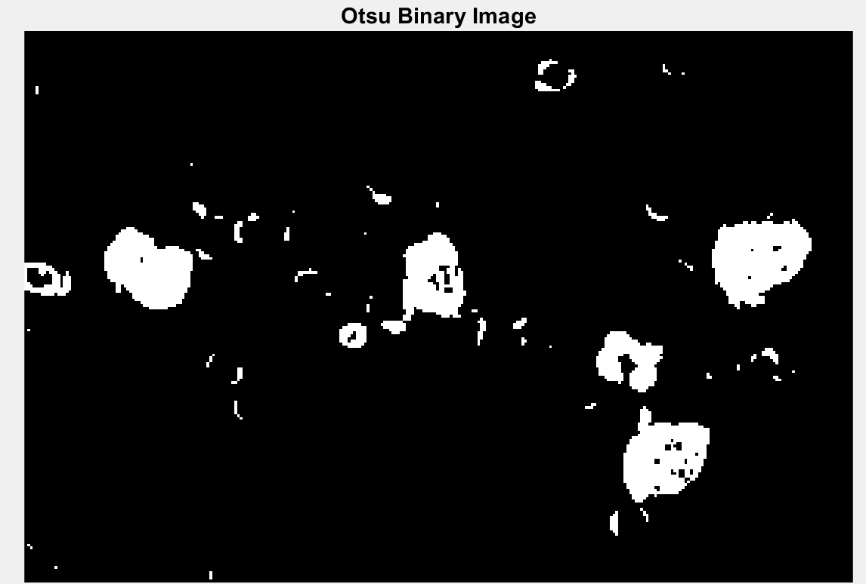
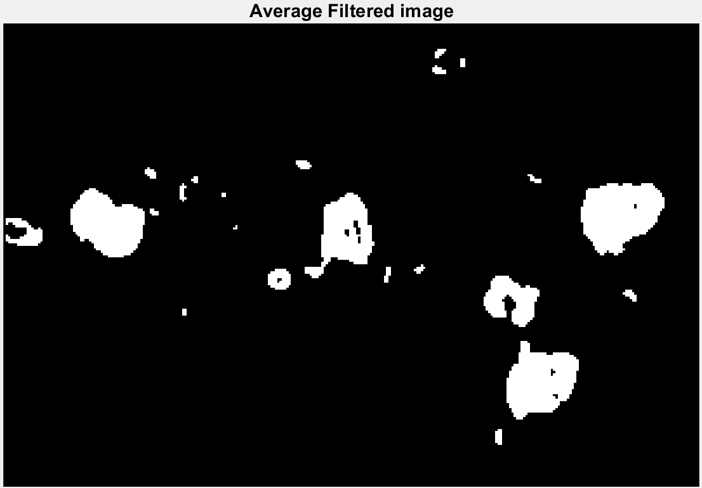
3. Image Segmentation: Dividing an image into blocks for identifying the noises. OTSU binary image: To perform automatic image thresholding by using binary values such as 0’s & 1’s Average filtered image: method of smoothing image by reducing the amount of intensity, variation between neighboring pixels.

Slide 11
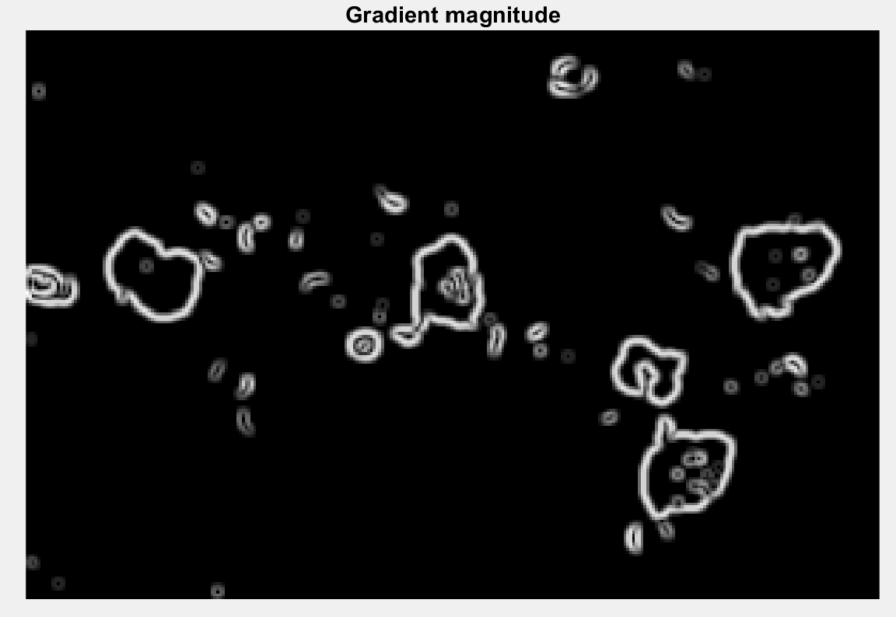
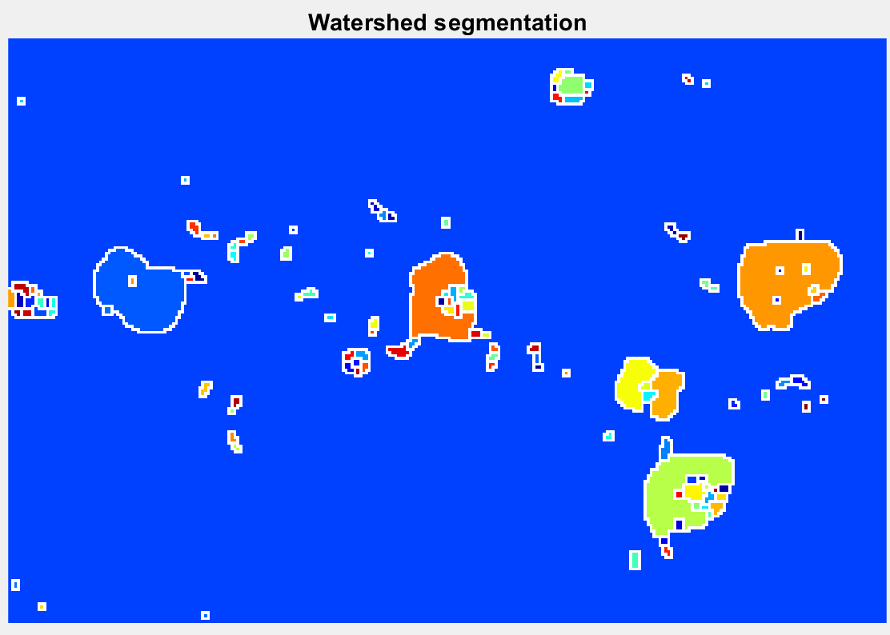
Gradient magnitude: it is a scalar quantity that describes the local rate of change in the scaler field. Watershed segmentation: transform decomposes an image completely and thus assigns each pixel either to a region.

Slide 12
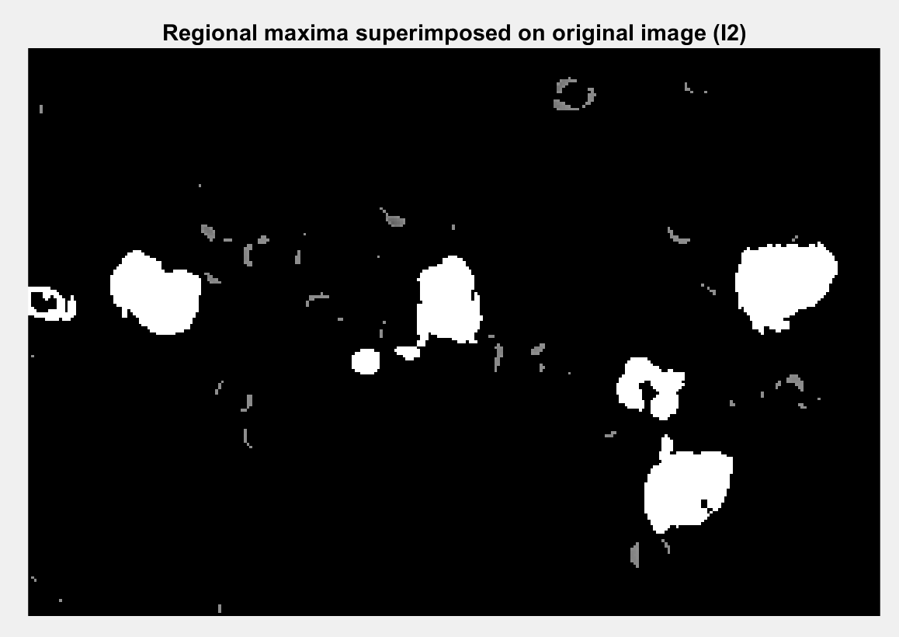
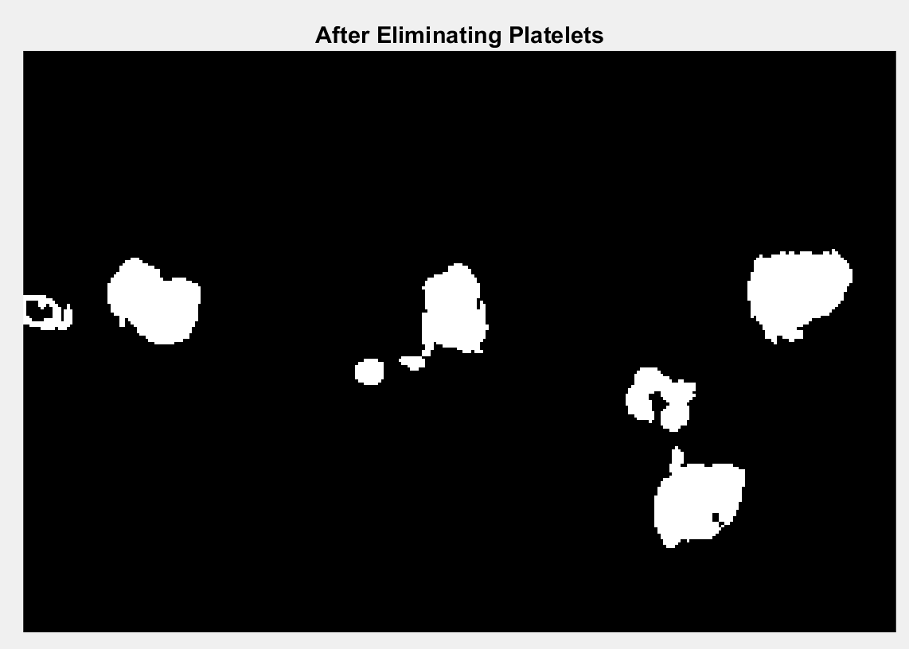
4.Feature extraction: Completely Eliminating platelets, boundaries noise, and also adjust the size of the nuclei. By superimposing with the original image noise is removed completely.

Slide 13
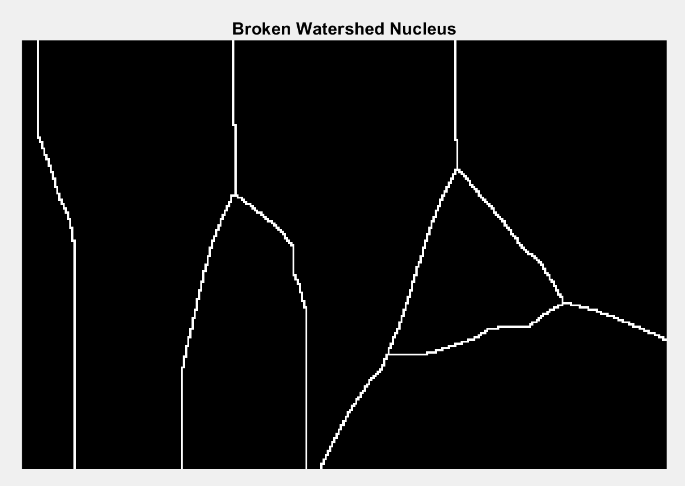
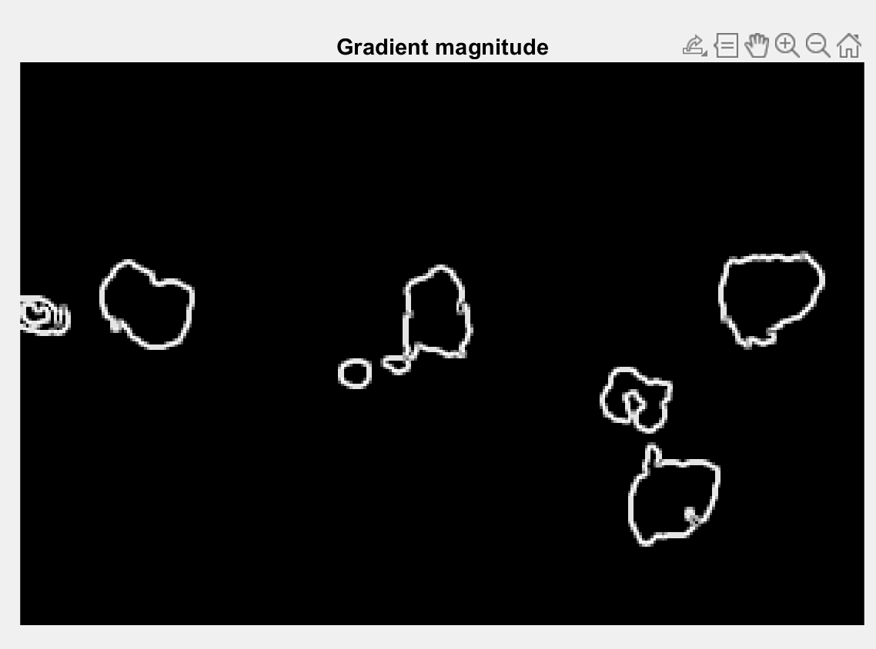
Broken watershed nucleus: to identify the exact position of the nucleus by taking an imaginary line. Highlight all the objects and their borders in the image including the cell nucleus borders.

Slide 14
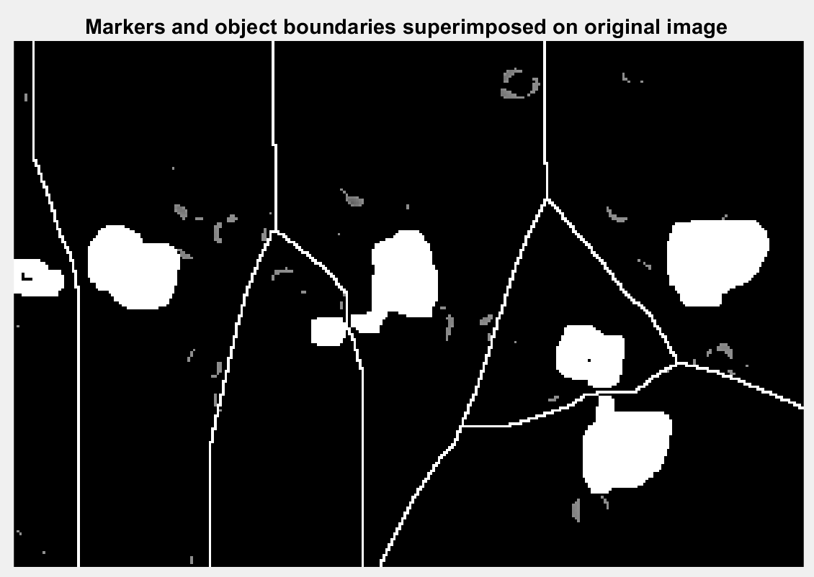
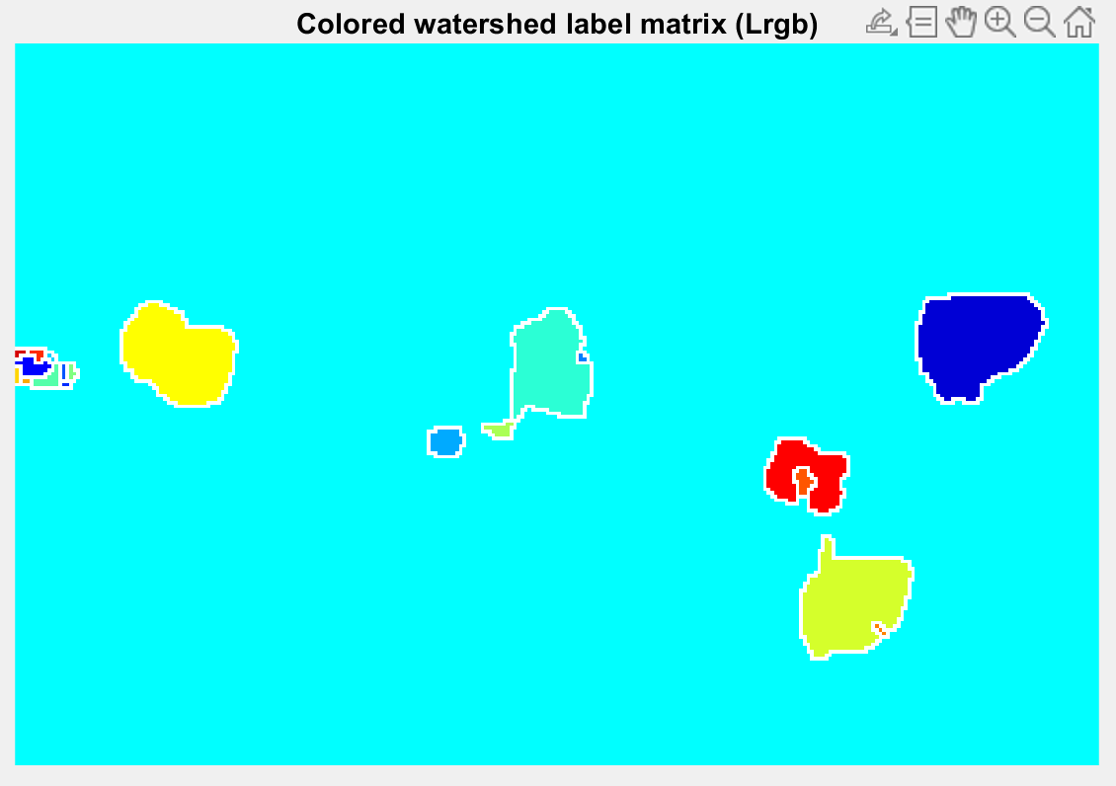
Superimposing on the original image to sink the nucleus to find the 100% accurate nucleus AND removing noise finally by color watershed tech.

Slide 15
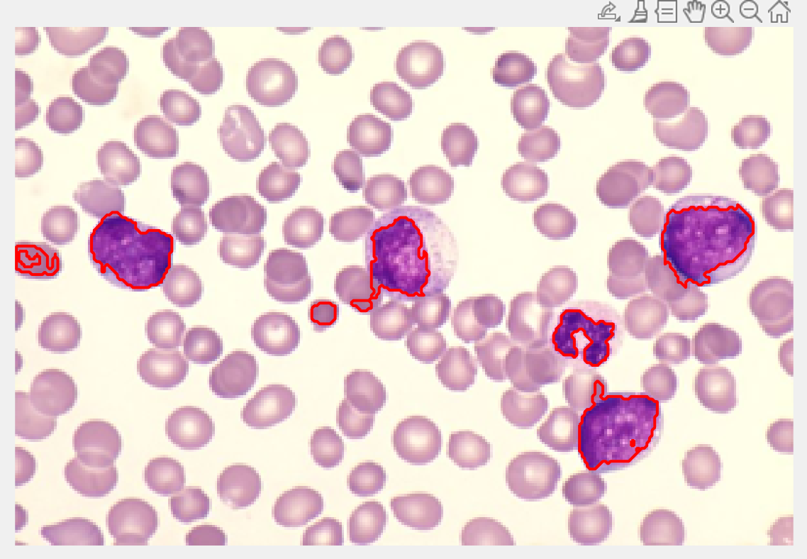
4.Final Step Identification of WBC :
Identification of exact WBC finally >The nucleus of WBC

Slide 16
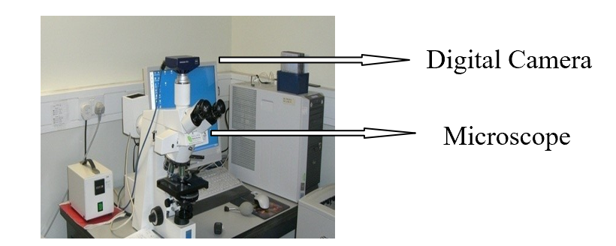
Advantages:
It is most accurate than other models as we are using image processing technique--- by this diagnosis, it is an accurate and easy model as it increases the time span of cure.
Significant reduction of labor requirements.
Bit costly and it just only identifies one type of blood cell.

Slide 17
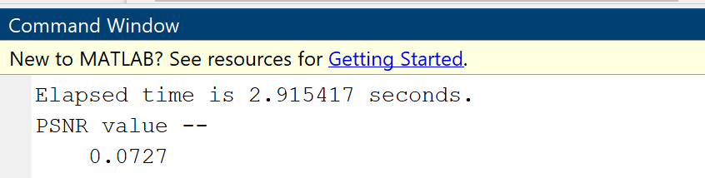
Future scope:
From PB samples images, We’ll get accurate results within a fraction of seconds and for the better treatment of a popular white blood cells disease called leukemia as it saves a lot of time.
Increases the diagnostic accuracy, thus saving more lives.
However, it is worthwhile to further extend the proposed methodology to be used for the morphological examination of PB images.

Slide 18
Thank you

